Slide 1
AI for Solving New York Times Connection Game
MSDS Capstone –FA 24 DSCI 6051-02
Project Advisor: Mohamad Nassar
Mentor: Khadka Ashish

Slide 2

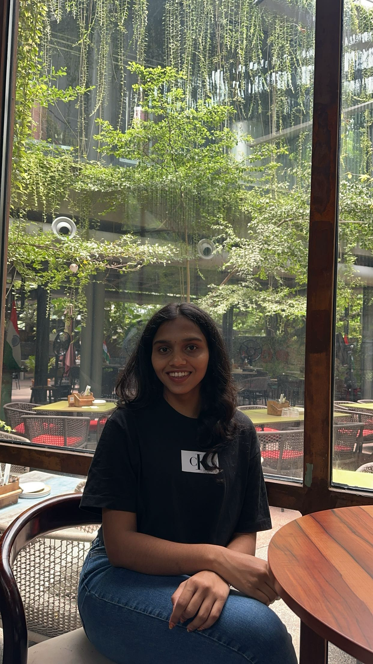


TEAM
Lakshmi Prasanna Kalluri
JAGANNATH PATRO ALLUPATI
Chaithra Angadi
SRIKANTH DUMPALA

Slide 3
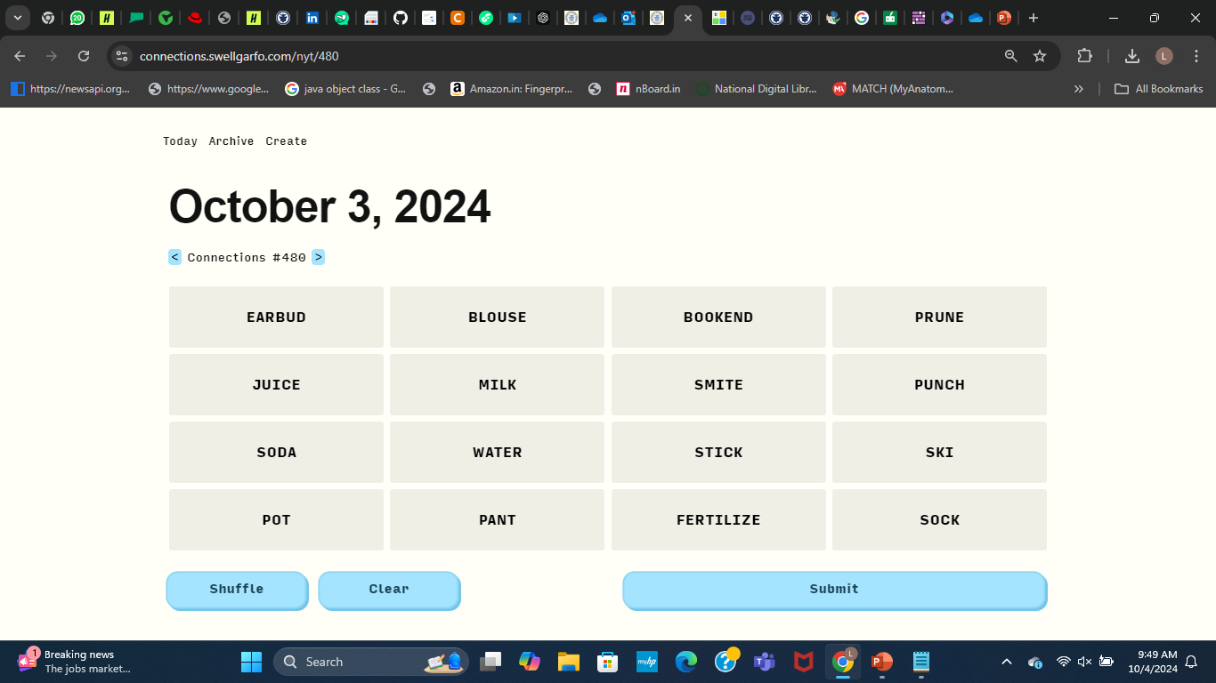
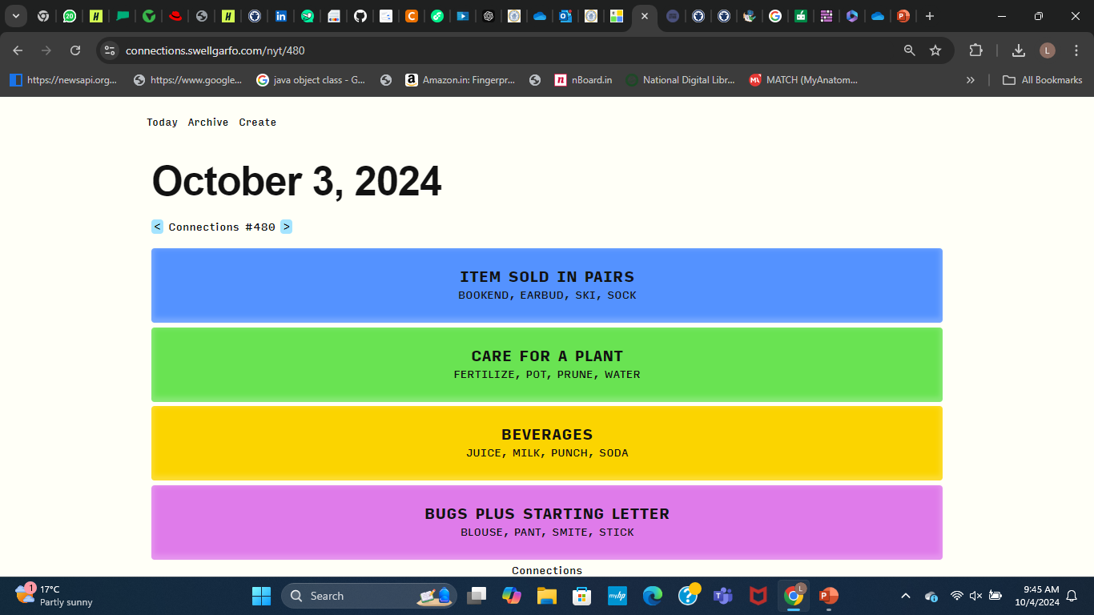
Overview
https://www.nytimes.com/games/connections
yellow - most straightforward
green, blue, and purple - trickiest

Slide 4

Introduction & Objectives
Objective: The primary objective of this project is to develop an AI-powered solution for the New York Times Connection Game by generating logical word groups and evaluating the AI-generated puzzles against the original puzzles to ensure accuracy and effectiveness.
Key Problem: The New York Times Connection Game requires efficient and accurate word grouping based on semantic relationships, which can be challenging to automate. Our project aims to address this issue by leveraging AI to ensure consistent and logical groupings that resemble the human comprehension.
Scope The project focuses on creating a Minimum Viable Product (MVP) that integrates:
Automated grouping of words for a given puzzle using Word2Vec and similarity measures.
A web-based interface for visualizing and interacting with grouped words.
Evaluation metrics to assess the accuracy and effectiveness of the generated groups.
Notes:
The New York Times Connection Game is a word puzzle that tests players' ability to group 16 words according to associations or common themes into 4 different groups.
https://www.nytimes.com/games/connections

Slide 5
Business Understanding
Business Objective: Enhance the NYT Connection Game by improving grouping accuracy and user engagement.
Success Criteria:
Business: Reliable and consistent word groupings that improve gameplay experience.
Technical: High success rates and accurate groupings that align with human-like understanding.
Planning
Tools: Word2Vec, Flask, Python (Gensim, NumPy, Plotly).
Steps: Data preparation, model development, evaluation, and deployment of a web-based interface for visualization and interaction.

Slide 6
Data Understanding & Preparation
Data Sources: Puzzles from the New York Times Connection Game.
Source: [NYT Puzzles JSON](https://anonymous.4open.science/r/making-new-connections-78D1/nyt_puzzles.json)
Integrated word embeddings using Word2Vec to represent words in a semantic vector space.
Some words were not present in the Word2Vec vocabulary. This was addressed by filtering out such words or substituting with similar ones.
Word embeddings generated for all valid words to facilitate similarity calculations.

Slide 7
Modeling
The primary model used was Word2Vec, a neural embedding model, to generate vector representations of words and calculate semantic similarities.
The Word2Vec model was trained using preprocessed word datasets.
Cosine similarity was calculated between word vectors to group semantically related words.
Start by forming 8 most similar word pairs using Word2Vec and cosine similarity.
Further combine these pairs into 4 final groups based on average similarity metrics.

Slide 8
Evaluation
Groups generated based on their similarities are evaluated through metrics like success rate and overlap with original groups.
The model demonstrated a significant success rate in replicating human-like groupings, achieving the desired standards of accuracy and logical consistency.

Slide 9
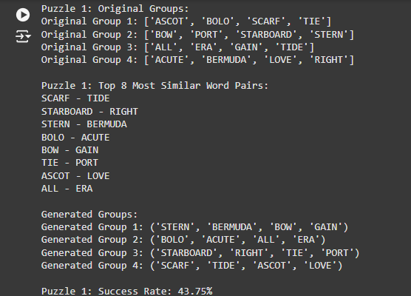
Results: Original and Generated Groups

Slide 10
Deployment
Product Demo

Slide 11
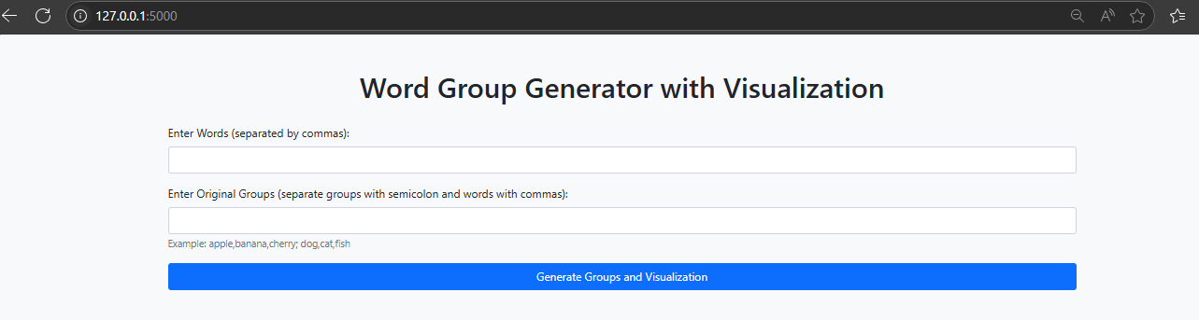
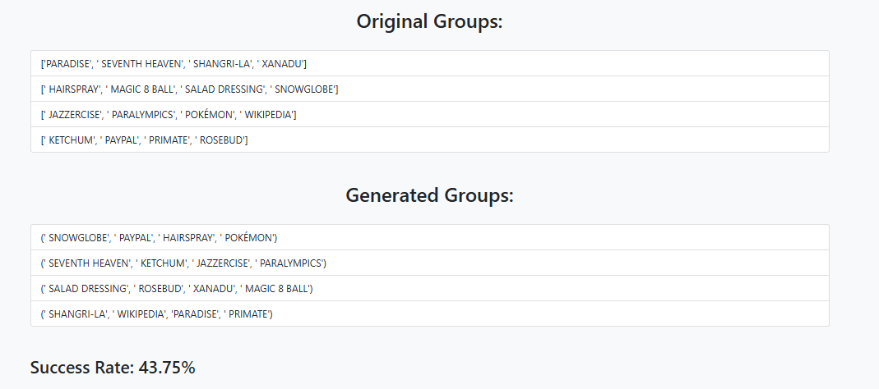
Web Interface: Word Group Generator

Slide 12
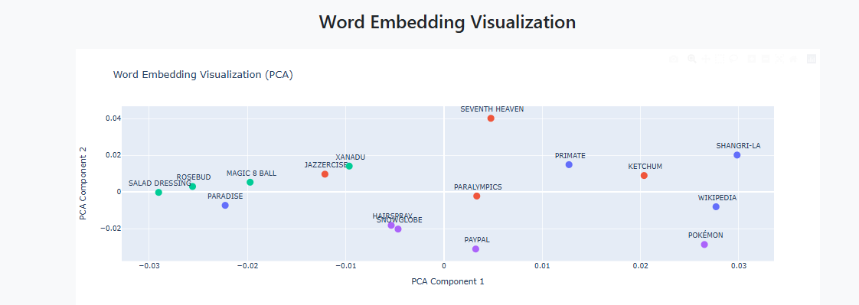
Word Embedding Visualization

Slide 13
What We Learned
Word Embeddings with Word2Vec: We explore how to train a Word2Vec model to generate word embeddings that capture semantic relationships between words
Cosine Similarity: The application demonstrates how to calculate cosine similarity between word vectors to assess their closeness in meaning.
Dimensionality Reduction with PCA: We utilize Principal Component Analysis (PCA) to reduce the dimensionality of word vectors for visualization, allowing us to plot the relationships between words.
Web Development with Flask: The app showcases how to build a web interface using Flask, handling user input, rendering templates, and generating interactive visualizations with Plotly.
TEAM GROWTH :
Algorithmic Thinking & Team Collaboration: Mastered problem-solving with computational approaches and enhanced teamwork through effective task division.

Slide 14
Future Recommendations
Refine the group generation process to ensure the formation of all correct groups level by level.
Use iterative approach to enhance the model's overall efficiency and reliability.
Train the model with a larger dataset containing more puzzles to improve its understanding of semantic relationships and grouping accuracy.

Slide 15


